Slide 1



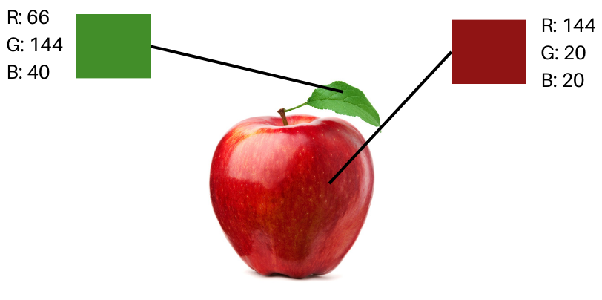
Session 1 :
Introduction to Image Processing

Slide 2
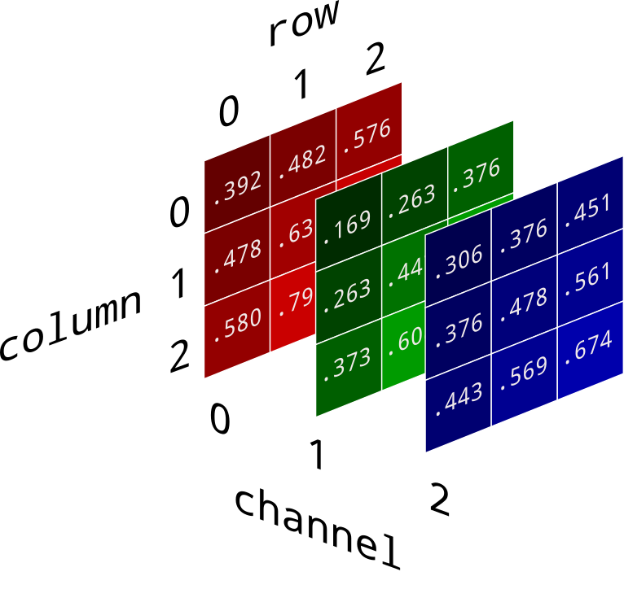
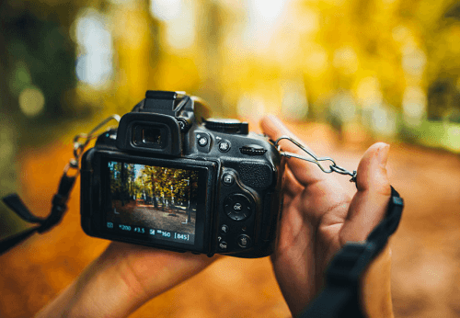
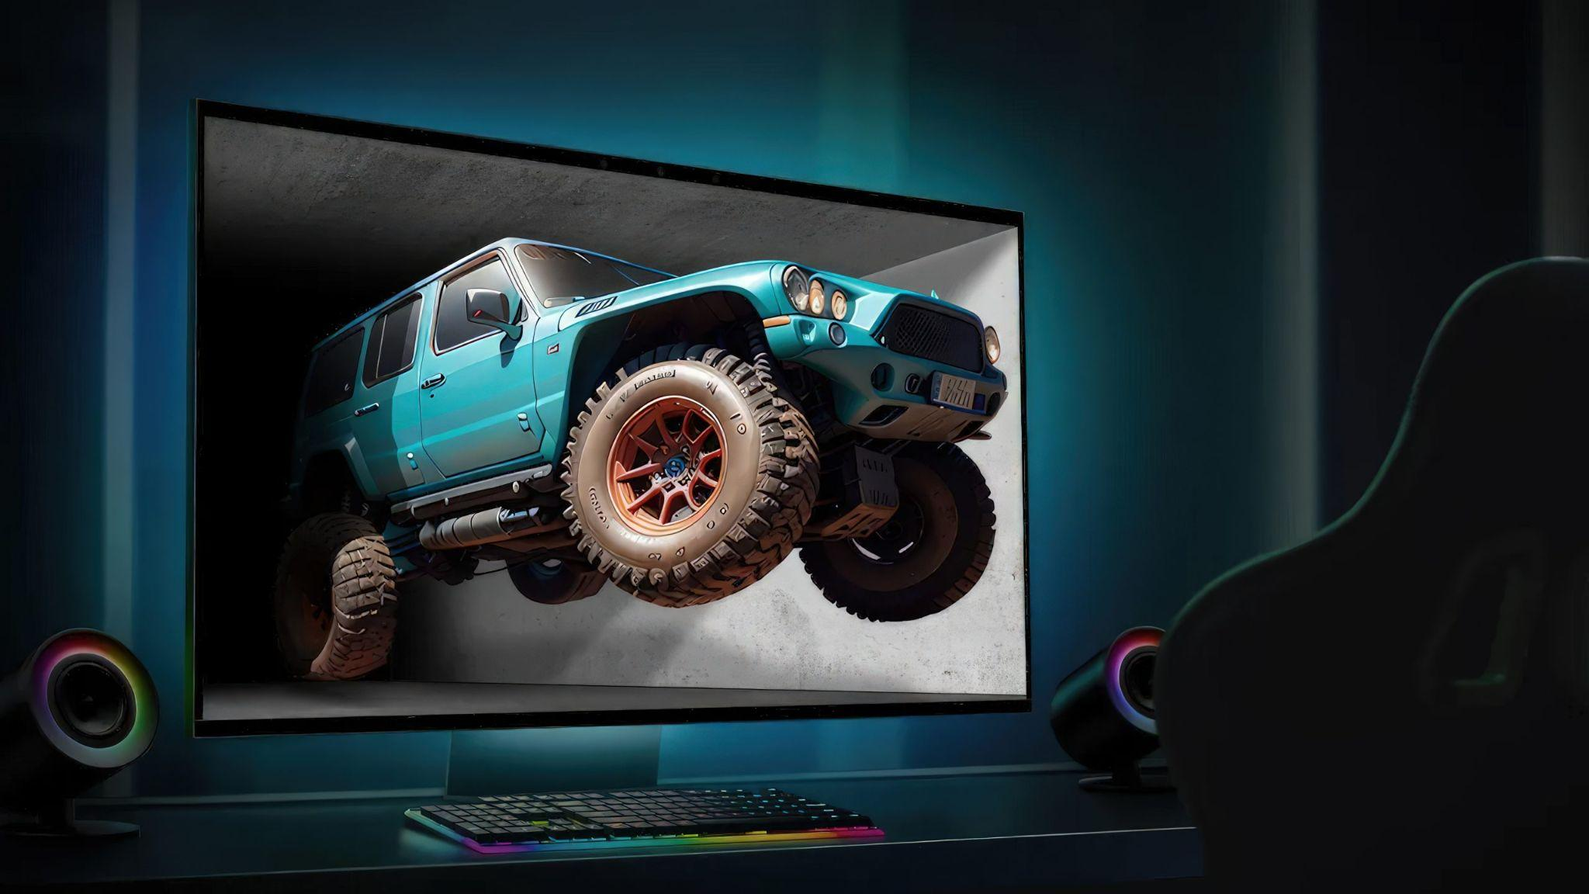
What is an image?
An image is a picture that shows something. It can be a drawing, a photo, or something made on a computer.
For example:
A photo of you is an image.
A drawing of a cat is an image.
A cartoon on TV is made of many images.

Slide 3
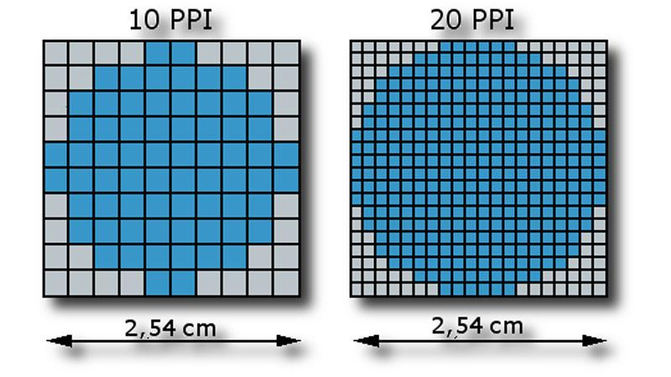
Images are made up of pixels.
An image is made up of tiny dots called pixels. Imagine a big puzzle made of tiny pieces—each piece is like a pixel!
When you look at a picture on a phone, TV, or computer, you are actually looking at millions of tiny pixels. Each pixel has a color, and when they are put together, they create a full image!
Just like LEGO bricks make a big shape
when put together, pixels make a picture when
arranged properly!

Slide 4

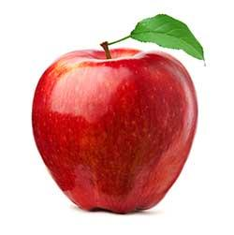
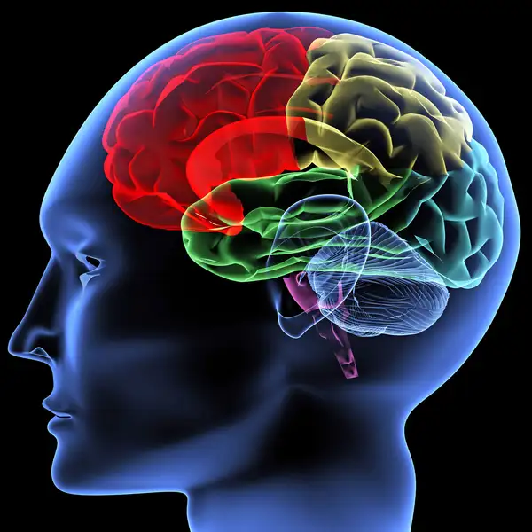
Human Vision vs. Computer Vision
Apple
Detected
Eye(Sensing device responsible for capturing images )
Brain(interpreting device responsible for understanding image content)

Slide 5
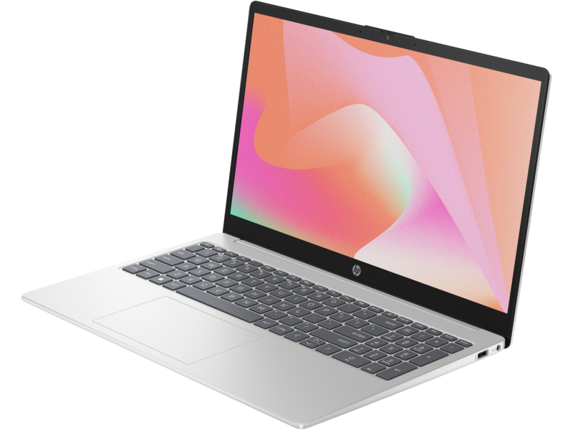
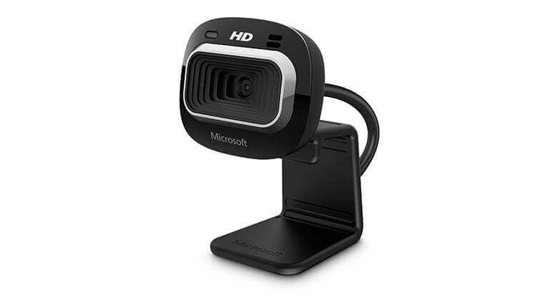
Human Vision vs. Computer Vision
Input
(Sensing device)
Apple Detected
(interpreting device)
Output

Slide 6
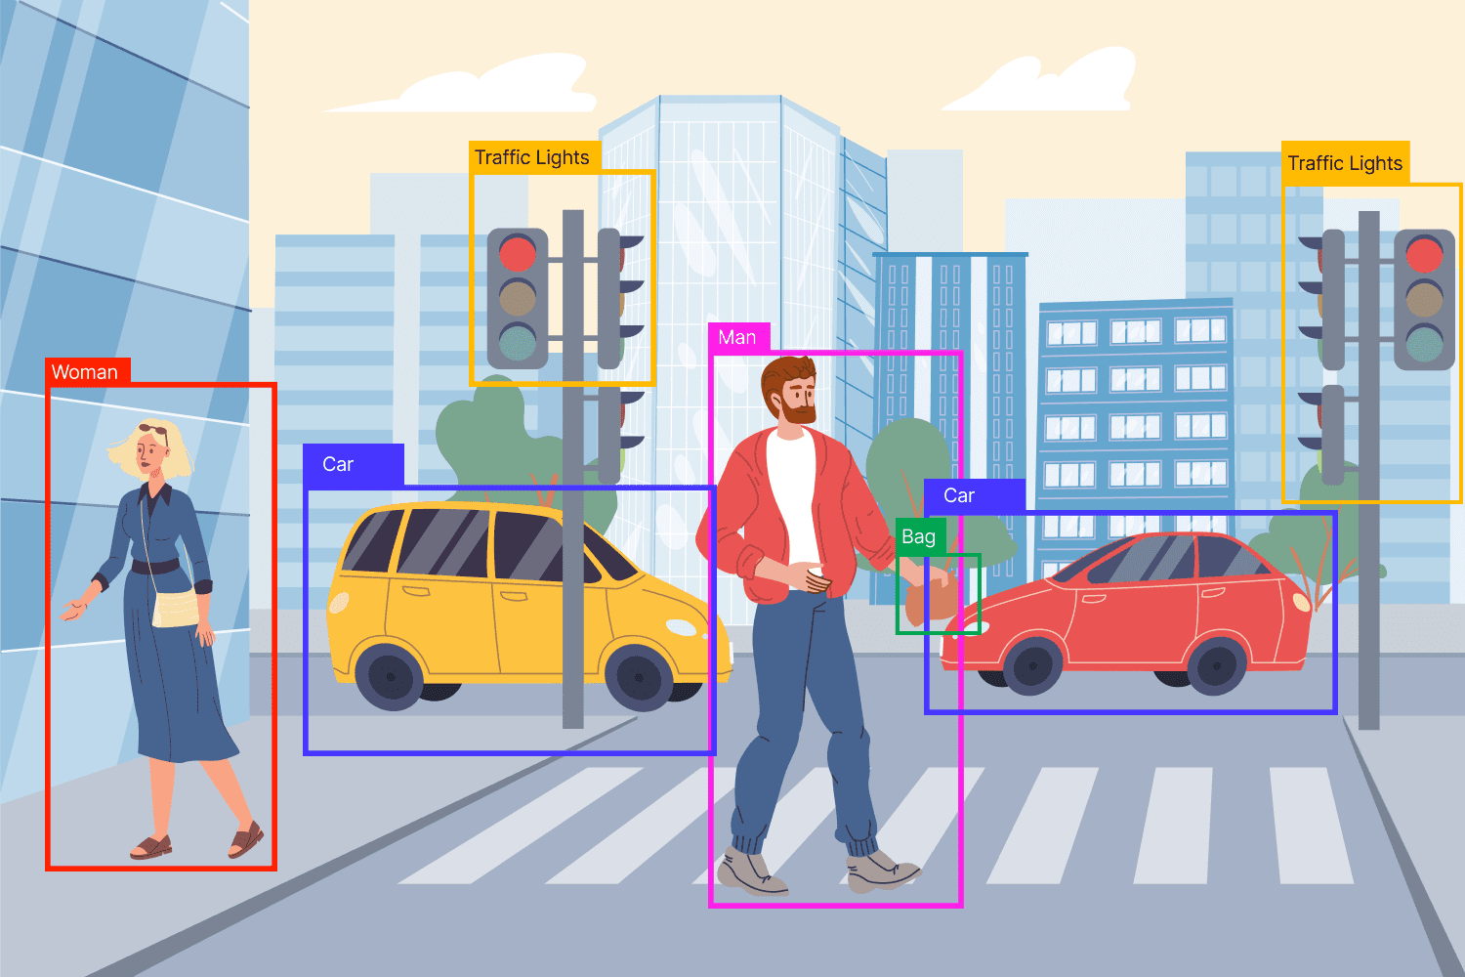
Human Vision vs. Computer Vision

Slide 7
Applications of Image Processing
Object Detection & Recognition
Real-time surveillance and security systems
Gesture and pose recognition
License plate recognition
AI & Deep Learning Applications
Image classification using CNNs (e.g., cats vs. dogs)
Facial recognition systems
Emotion detection
Scene understanding in autonomous vehicles

Slide 8
Applications of Image Processing
Medical Imaging
MRI, CT scan, and X-ray analysis
Tumor detection
Retinal image segmentation
Automated diagnosis tools
Augmented Reality & Games
Overlaying virtual objects on live video
Real-time filters like those on Instagram or Snapchat

Slide 9
Applications of Image Processing
Industrial Automation
Defect detection in manufacturing (quality control)
Barcode/QR code reading
Sorting objects by size/shape/color
Photo Editing & Enhancement
Image filters, cropping, resizing
Background removal and replacement
Color correction and enhancement
Sharpening, blurring, contrast/brightness adjustments

Slide 10
Applications of Image Processing
Robotics & Navigation
Line following and path planning
SLAM (Simultaneous Localization and Mapping)
Object tracking for pick-and-place robots
E-commerce & Retail
Virtual try-on (e.g., glasses, clothes)
Product image enhancement
Visual search (upload a photo to find a similar product)

Slide 11
What is Pixel Structure?
Each pixel has three small lights inside it:
🔴 Red
🟢 Green
🔵 Blue
These colors mix together to make all the colors you see on a screen!
Example:
If a pixel turns all three lights on fully, it makes white
If all lights are off, it makes black ⚫.
If only the red light is on, the pixel looks red 🔴.
By changing how bright each light is, we can make millions of colors!
So, a pixel structure is just the way these tiny dots are arranged to make beautiful images on your screen!

Slide 12
Essential Libraries for Image processing
OpenCV
Numpy
To help computers with vision tasks, we use a special tool called OpenCV (Open Source Computer Vision Library). It's like a set of building blocks in the programming language Python that allows us to create programs enabling computers to:
Recognize faces and objects.
Understand gestures and movements.
Analyze images and videos.
Run in terminal
pip install opencv-python numpy

Slide 13
Why using cv2(OpenCv)
OpenCV (cv2) is a library used for image processing.
NumPy creates the image as a matrix of pixels.
OpenCV (cv2) helps display it on the screen efficiently.
In the python script cv2 is used for following purpose
Displaying the Image (cv2.imshow())
OpenCV provides cv2.imshow("Pixel Grid", img), which quickly opens a window to show images stored as NumPy arrays.
Handling User Interaction (cv2.waitKey(0))
This keeps the window open until a key is pressed.
If we don't use cv2.waitKey(0), the image window would open and close immediately
Closing the Window Properly (cv2.destroyAllWindows())
This ensures that all OpenCV-created windows are closed properly when the user exits.

Slide 14
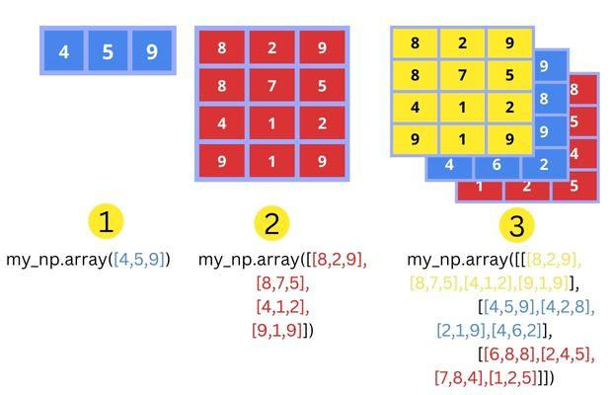
Why using Numpy ( Numerical Python)
Images are essentially grids of pixels, which can be represented as arrays.
NumPy makes it easy to create and manipulate these arrays efficiently.
Try this code: to verify
Import cv2
Img = cv2.imread(“pic.jpg”)
print(img)

Slide 15
Python script to create and display a simple black image on window.
import numpy as np
import cv2
img = np.zeros((512, 512, 3), dtype = np.uint8) #Create a black image zero means 0 for all BGR
cv2.imshow("Window", img) # Show the window
cv2.waitKey(0) # holds the window
cv2.destroyAllWindows() # close the window properly

Slide 16
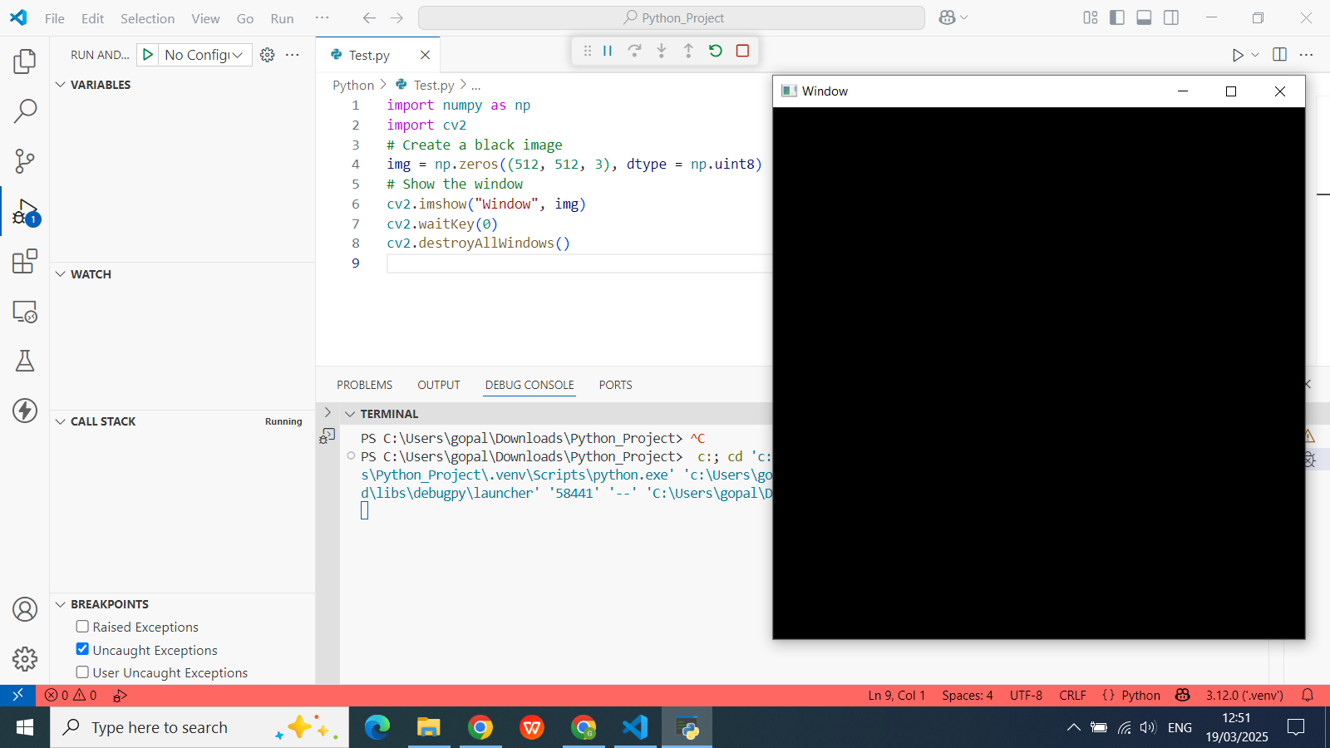
Output

Slide 17
Write a Python script to create and display a simple black-and-white pixel grid.
import numpy as np
import cv2
def create_grid(rows=10, cols=10, size=20):# Function to create a black-and-white grid
# Create a white background grid
grid = np.ones((rows*size, cols*size), dtype=np.uint8) * 255
# Fill alternating squares with black to create a checkerboard pattern
for i in range(rows):
for j in range(cols):
if (i+j) % 2 == 0: # Alternate black and white squares
grid[i*size:(i+1)*size, j*size:(j+1)*size] = 0
return grid
cv2.imshow('Grid', create_grid()) # Display the generated grid using OpenCV
cv2.waitKey(0)
cv2.destroyAllWindows()

Slide 18
Exercise
1. Which of the following libraries is primarily used for numerical operations on arrays in image processing with Python?
A. Matplotlib
B. NumPy
C. TensorFlow
D. Seaborn
Answer: B. NumPy
2. In OpenCV, which function is used to read an image from a file? A. cv2.show() B. cv2.imread() C. cv2.readimage() D. cv2.load()
Answer: B. cv2.imread()

Slide 19
Exercise
3. What is the default color format used by OpenCV when reading an image? A. RGB B. BGR C. CMYK D. HSV
Answer: B. BGR
4. Which NumPy function is used to get the shape (dimensions) of an image array? A. array.size() B. array.type() C. array.shape D. array.length()
Answer: C. array.shape

Slide 20
Exercise
5. What does the following line of code do? gray = cv2.cvtColor(image, cv2.COLOR_BGR2GRAY) A. Converts a grayscale image to RGB B. Converts an image to black and white C. Converts a BGR image to grayscale D. Converts an image to HSV format
Answer: C. Converts a BGR image to grayscale

